Slide 1
Data Dictionary
Name | Description | Type_Coding
annual_kwh | yearly electricity use | Continuous (kWh/year)
sq_meters | indoor living area | Continuous (m²)
epc_label | energy performance certificate | Ordinal: A, B, ..., F
building_era | construction period | Ordinal: ref = Pre-1970, 1970-2000, post-2000
income_euro | net household income | Continuous (€/year)
occupancy_count | permanent residents | Count: 1, 2, ..., n
dist_to_brussels | distance to Brussels center | Continuous (km)
roof_color | roof tile color | Categorical: red, black, other
pet_ownership | owner has a pet | Binary: 0 = No, 1 = Yes

Slide 2
annual_kwh | sq_meters | epc_label | building_era | income_euro | occupancy_count | dist_to_brussels | roof_color | pet_ownership
267 | 5372190.00 | 156.15 | C | 1970-2000 | 44737.59 | 4 | 118.72 | Black | 0
1330 | 4635780.00 | 114.28 | D | Pre-1970 | 12830.40 | 4 | 70.93 | Other | 1
1570 | 4428940.00 | 154.49 | F | Pre-1970 | 64433.95 | 1 | 75.62 | Black | 0
369 | 4004330.00 | 133.92 | D | 1970-2000 | 58718.83 | 2 | 107.05 | Black | 0
12 | 2955140.00 | 100.34 | A | Post-2000 | 31930.12 | 3 | 114.33 | Other | 1
77 | 17197.12 | 268.11 | F | Pre-1970 | 115384.00 | 7 | 81.56 | Red | 1
1038 | 16395.02 | 304.18 | E | Pre-1970 | 131393.77 | 7 | 50.92 | Other | 0
1051 | 14024.23 | 204.98 | F | Pre-1970 | 81213.77 | 7 | 79.91 | Red | 1
452 | 13872.60 | 177.94 | F | Pre-1970 | 73933.89 | 7 | 30.24 | Other | 1
2057 | 13821.56 | 162.59 | F | Pre-1970 | 36281.03 | 7 | 110.78 | Black | 0

Slide 3
Missing data summary
Variable | Missing_n | Missing_pct
annual_kwh | 5 | 0.2
sq_meters | 5 | 0.2
epc_label | 5 | 0.2
income_euro | 5 | 0.2
occupancy_count | 5 | 0.2
dist_to_brussels | 5 | 0.2
building_era | 0 | 0.0
roof_color | 0 | 0.0
pet_ownership | 0 | 0.0

Slide 4
Summary tables for categorical varibales
 | Characteristic | N = 2,482¹
epc_label | A | 552 (22%)
 | B | 436 (18%)
 | C | 529 (21%)
 | D | 389 (16%)
 | E | 336 (14%)
 | F | 240 (9.7%)
building_era | 1970-2000 | 852 (34%)
 | Post-2000 | 808 (33%)
 | Pre-1970 | 822 (33%)
roof_color | Black | 827 (33%)
 | Other | 783 (32%)
 | Red | 872 (35%)
pet_ownership | Yes | 983 (40%)
 | Characteristic | N = 2,482¹
occupancy_count | 1 | 351 (14%)
 | 2 | 355 (14%)
 | 3 | 343 (14%)
 | 4 | 378 (15%)
 | 5 | 375 (15%)
 | 6 | 341 (14%)
 | 7 | 339 (14%)

Slide 5
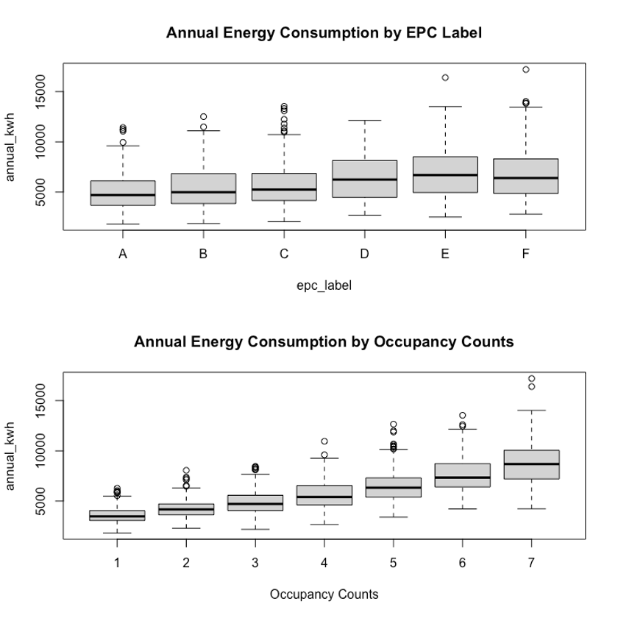

Slide 6
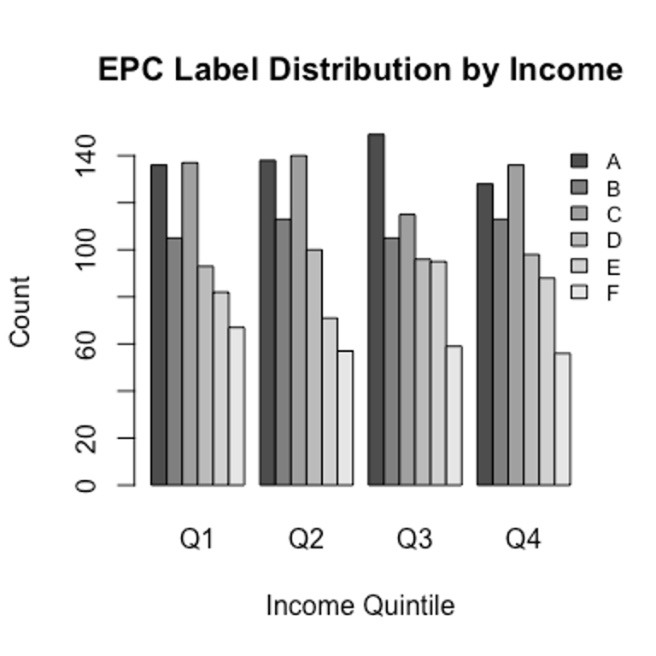

Slide 7
Summary tables for continuous varibales
Characteristic | Mena±sd | Median, IQR
annual_kwh | 14,483± (194,970) | 5,436(4,198, 7,197)]
sq_meters | 158± (36) | 156(134, 181)
dist_to_brussels | 63± (33) | 63(34, 92)
income_euro | 48,830± (22,530) | 44,546(32,915, 58,818)

Slide 8
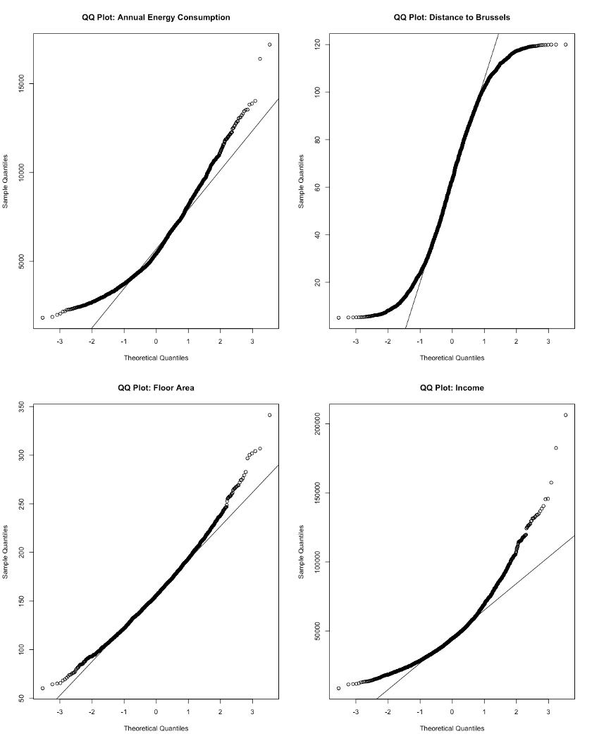
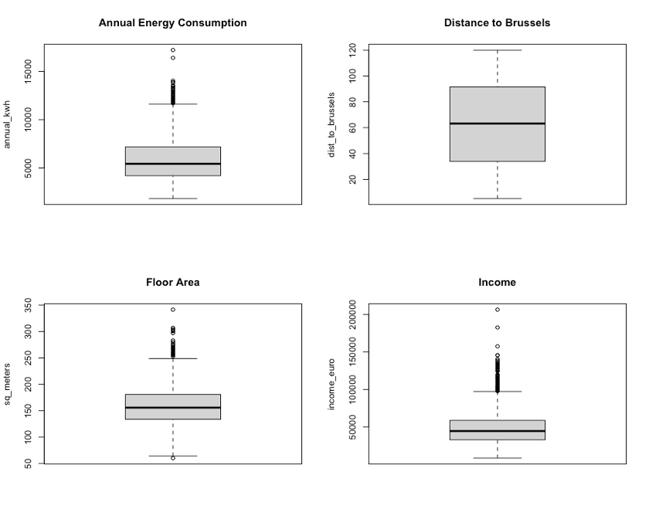

Slide 9
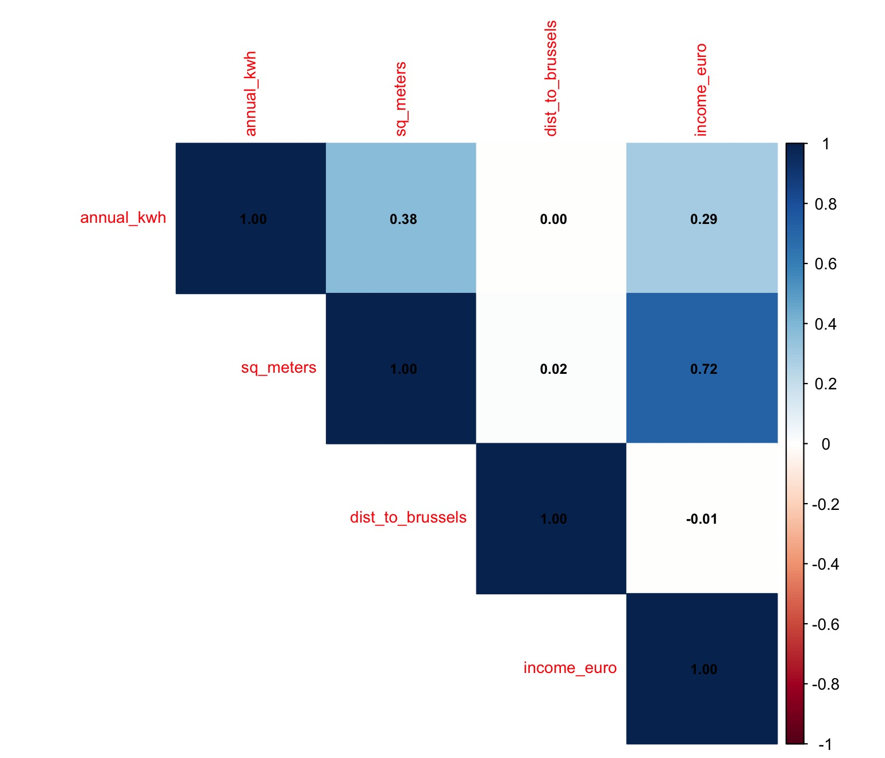
Correlation plots for continuous variables

Slide 10
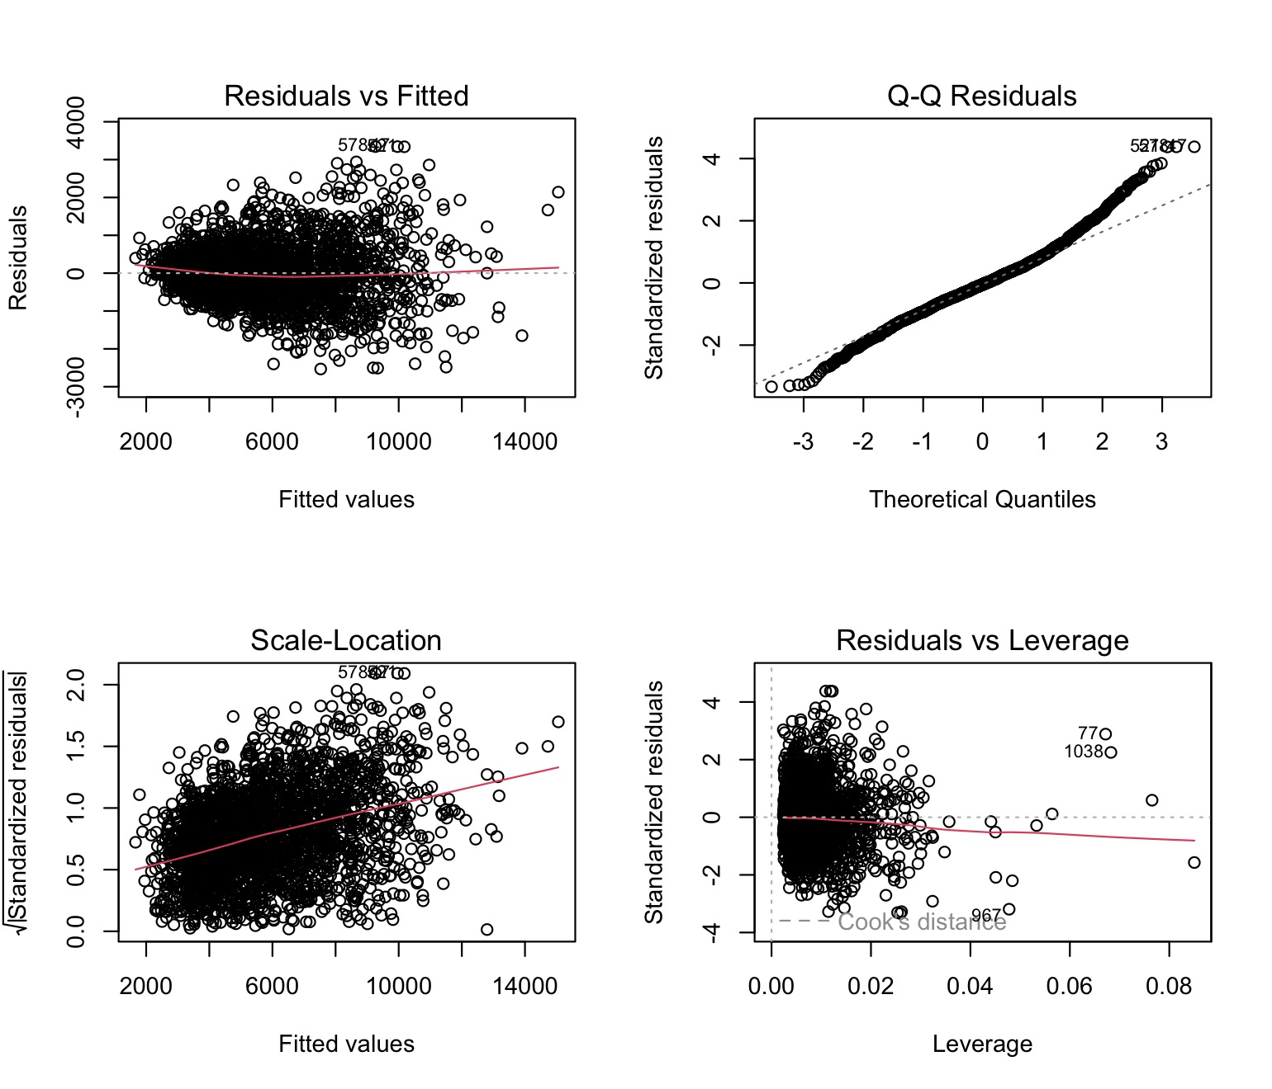
Initial_model

Slide 11
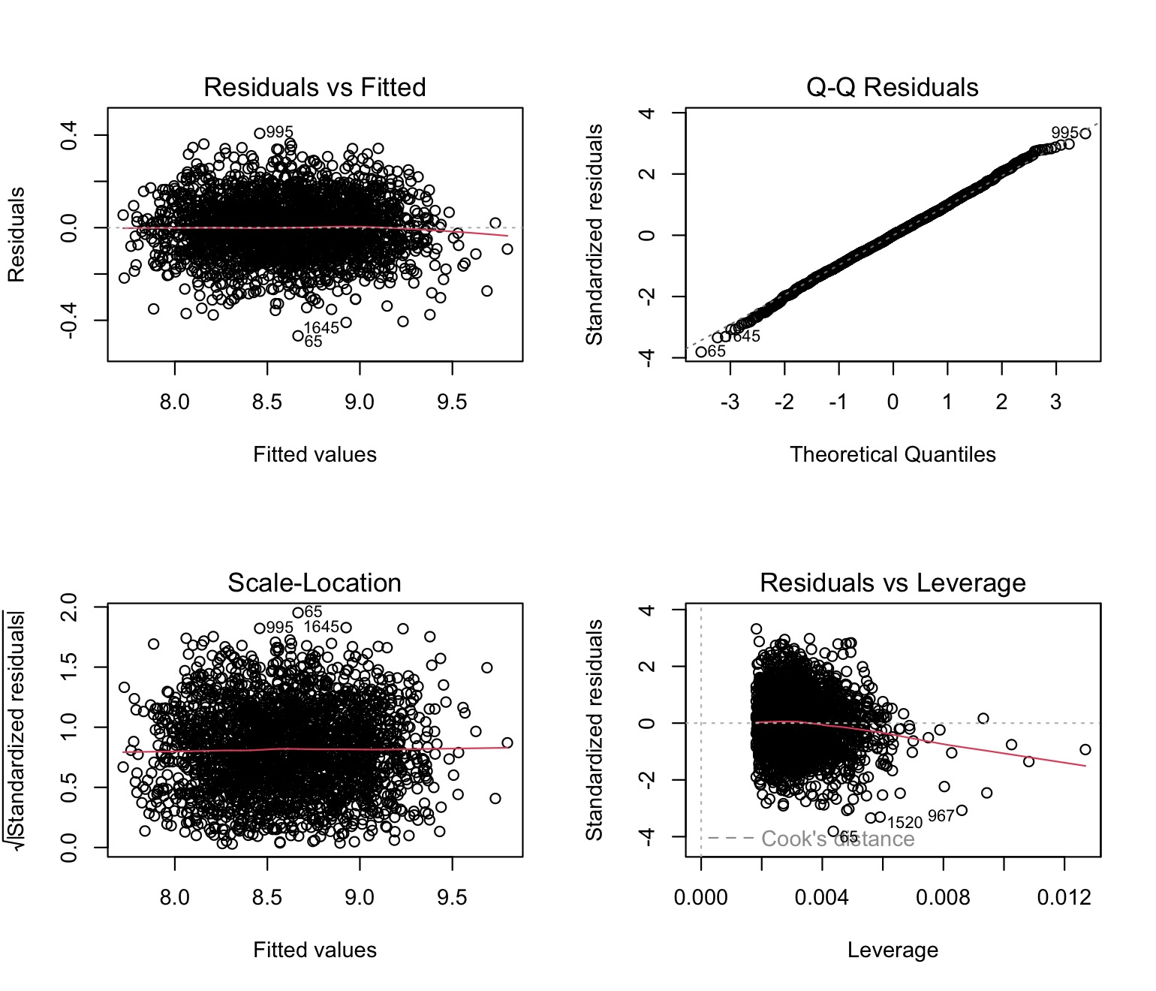
model_log

Slide 12
Model comparison (initial,log-model, and final) using AIC, BIC, and Adj-R-squared
Table 1
Model | AIC | BIC | Adj_R2
Initial_model | 39966.475 | 40094.400 | 0.881
model_log | -3350.746 | -3298.412 | 0.891
Final_model | -3347.589 | -3283.627 | 0.891

Slide 13
 | Beta | Std. Error | p-value | OR | CI 2.5% | CI 97.5%
(Intercept) | 7.220 | 0.020 | 0.000 | 1366.238 | 1313.456 | 1421.142
sq_meters | 0.004 | 0.000 | 0.000 | 1.004 | 1.004 | 1.004
epc_labelB | 0.087 | 0.009 | 0.000 | 1.091 | 1.071 | 1.111
epc_labelC | 0.157 | 0.014 | 0.000 | 1.170 | 1.137 | 1.203
epc_labelD | 0.238 | 0.015 | 0.000 | 1.268 | 1.232 | 1.306
epc_labelE | 0.316 | 0.017 | 0.000 | 1.371 | 1.325 | 1.419
epc_labelF | 0.394 | 0.018 | 0.000 | 1.482 | 1.431 | 1.535
Built 1970–2000 | -0.009 | 0.009 | 0.361 | 0.991 | 0.973 | 1.010
Built post-2000 | -0.010 | 0.015 | 0.531 | 0.991 | 0.961 | 1.020
occupancy_count | 0.151 | 0.001 | 0.000 | 1.163 | 1.160 | 1.166

Slide 14
Anova Table
 | Df | Sum Sq | Mean Sq | F value | Pr(>F)
sq_meters | 1 | 48.59 | 48.59 | 3221.69 | 0.0
epc_label | 5 | 36.03 | 7.21 | 477.69 | 0.0
building_era | 2 | 0.03 | 0.01 | 0.91 | 0.4
occupancy_count | 1 | 220.09 | 220.09 | 14591.69 | 0.0
Residuals | 2467 | 37.21 | 0.02 | NA | NA

Slide 15
Contrast results for the EPC Labels
 | OR | CI_2.5 | CI_97.5 | p.value
B - A | 1.0909 | 1.0666 | 1.1158 | <0.001
C - A | 1.1696 | 1.1300 | 1.2106 | <0.001
D - A | 1.2681 | 1.2231 | 1.3148 | <0.001
E - A | 1.3715 | 1.3148 | 1.4307 | <0.001
F - A | 1.4823 | 1.4191 | 1.5482 | <0.001

Slide 16
Model goodness after inclusing income as a regressor
 | df | BIC
modelincom | 17 | -3238.844
final_model | 11 | -3283.627
VIF result after including the income
 | GVIF | Df | GVIF^(1/(2*Df))
sq_meters | 2.117061 | 1 | 1.455012
epc_label | 12.820059 | 5 | 1.290592
building_era | 12.701413 | 2 | 1.887830
occupancy_count | 1.020948 | 6 | 1.001729
income_euro | 2.117228 | 1 | 1.455070

Slide 17
 | Estimate | Std. Error | t value | p-value
(Intercept) | 7.37287 | 0.02054 | 358.96074 | 0.00000
sq_meters | 0.00392 | 0.00010 | 39.76330 | 0.00000
epc_labelB | 0.08696 | 0.00931 | 9.34052 | 0.00000
epc_labelC | 0.15669 | 0.01422 | 11.01650 | 0.00000
epc_labelD | 0.23767 | 0.01493 | 15.91743 | 0.00000
epc_labelE | 0.31650 | 0.01746 | 18.12915 | 0.00000
epc_labelF | 0.39413 | 0.01799 | 21.91291 | 0.00000
building_era1970-2000 | -0.00818 | 0.00944 | -0.86619 | 0.38647
building_eraPost-2000 | -0.00890 | 0.01524 | -0.58388 | 0.55936
occupancy_count2 | 0.14616 | 0.00928 | 15.74459 | 0.00000
occupancy_count3 | 0.30127 | 0.00935 | 32.21282 | 0.00000
occupancy_count4 | 0.45892 | 0.00914 | 50.22731 | 0.00000
occupancy_count5 | 0.60170 | 0.00915 | 65.78431 | 0.00000
occupancy_count6 | 0.75188 | 0.00937 | 80.22590 | 0.00000
occupancy_count7 | 0.90614 | 0.00938 | 96.61101 | 0.00000
income_euro | 0.00000 | 0.00000 | 0.60927 | 0.54240

Slide 18
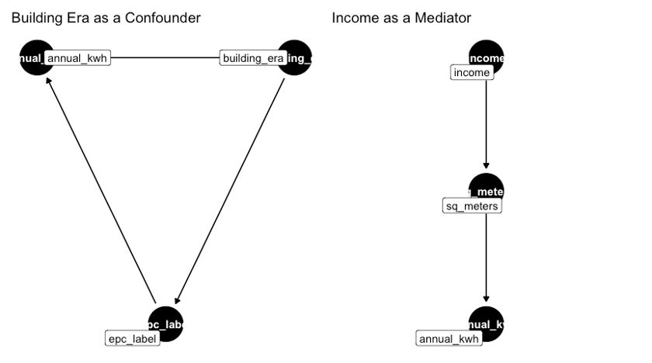

Slide 19
Results Interaction between EPC Label and Occupancy Count
 | Estimate | Std. Error | t value | p-value
(Intercept) | 7.6770 | 0.0151 | 510.0345 | 0.0000
occupancy_count2 | 0.1580 | 0.0129 | 12.2821 | 0.0000
occupancy_count3 | 0.3038 | 0.0130 | 23.3722 | 0.0000
occupancy_count4 | 0.4661 | 0.0127 | 36.7655 | 0.0000
occupancy_count5 | 0.5914 | 0.0127 | 46.5063 | 0.0000
occupancy_count6 | 0.7620 | 0.0133 | 57.4203 | 0.0000
occupancy_count7 | 0.9087 | 0.0132 | 69.0967 | 0.0000
epc_high | -0.0913 | 0.0178 | -5.1266 | 0.0000
sq_meters | 0.0039 | 0.0001 | 53.2163 | 0.0000
building_era1970-2000 | -0.1290 | 0.0070 | -18.4861 | 0.0000
building_eraPost-2000 | -0.1895 | 0.0131 | -14.4834 | 0.0000
occupancy_count2:epc_high | -0.0149 | 0.0208 | -0.7183 | 0.4726
occupancy_count3:epc_high | -0.0027 | 0.0209 | -0.1285 | 0.8978
occupancy_count4:epc_high | -0.0152 | 0.0205 | -0.7443 | 0.4568
occupancy_count5:epc_high | 0.0149 | 0.0204 | 0.7297 | 0.4657
occupancy_count6:epc_high | -0.0196 | 0.0208 | -0.9436 | 0.3454
occupancy_count7:epc_high | -0.0108 | 0.0209 | -0.5180 | 0.6045

